Slide 1

Decision Tree
Dr. Retno Kusumaningrum, S.Si., M.Kom.

Slide 2
Definition
Decision Tree

Slide 3
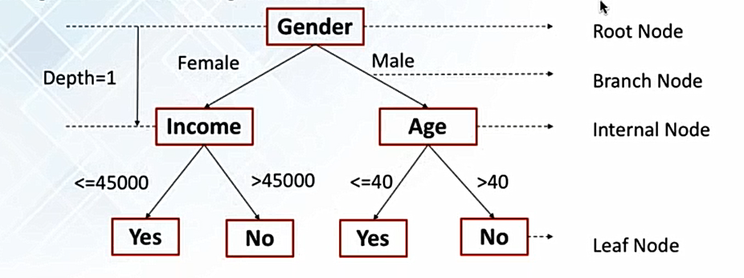
A Decision Tree
Uses tree structure to specify sequences of decisions and consequences
Employs a structure of nodes and branches
The depth of a node is the minimum number of steps required to reach the node from the root node
Eventually, a final point is reached and a prediction is made

Slide 4
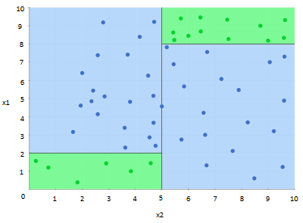

Identifying the region (blue or green) A point lies in a classification problem (blue vs green)

Slide 5
How It Works?
Decision Tree

Slide 6
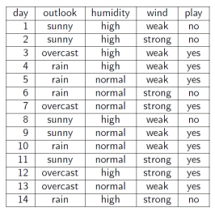
Predict wether to play tennis or not?
It is hard to guess
Try to understand when John plays
Divide and Conquer
Split into subset
Are they pure? (all yes or all No)
If Yes : stop
If No : continue
See which subset new data falls into
9 Yes
–
5 No
New Data : rain high weak ?

Slide 7
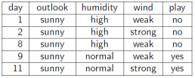
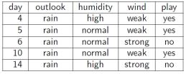

Outlook
Sunny
Overcast
Rain
2 Yes / 3 No ➔ Split Further
3Yes / 2 No ➔ Split Further
4 Yes / 0 No ➔ Pure Subset

Slide 8


Outlook
Sunny
Overcast
Rain
Humidity
High
Normal
0 Yes / 3 No ➔ Pure Subset
2 Yes / 0 No ➔ Pure Subset

Slide 9
Outlook
Sunny
Overcast
Rain
4 Yes / 0 No ➔ Pure Subset
Humidity
3Yes / 2 No ➔ Split Further
High
Normal
0 Yes / 3 No ➔ Pure Subset
2 Yes / 0 No ➔ Pure Subset

Slide 10


Outlook
Sunny
Overcast
Rain
4 Yes / 0 No ➔ Pure Subset
Humidity
Wind
High
Normal
0 Yes / 3 No ➔ Pure Subset
2 Yes / 0 No ➔ Pure Subset
Strong
Weak
0 Yes / 2 No ➔ Pure Subset
3 Yes / 0 No ➔ Pure Subset

Slide 11
Outlook
Sunny
Overcast
Rain
4 Yes / 0 No ➔ Pure Subset
Humidity
Wind
High
Normal
0 Yes / 3 No ➔ Pure Subset
2 Yes / 0 No ➔ Pure Subset
Strong
Weak
0 Yes / 2 No ➔ Pure Subset
3 Yes / 0 No ➔ Pure Subset

Slide 12
Outlook
Sunny
Overcast
Rain
Yes
Humidity
Wind
High
Normal
Strong
Weak
No
Yes
No
Yes

Slide 13
Outlook
Sunny
Overcast
Rain
Yes
Humidity
Wind
High
Normal
Strong
Weak
No
Yes
No
Yes
New Data : Outlook – rain, Humidity – high, and Wind – weak ?
Prediction : Play Tennis

Slide 14
Which Attribute to Split On?
Decision Tree

Slide 15
9Yes / 5 No
9Yes / 5 No
Outlook
Wind
Sunny
Overcast
Rain
Weak
Strong
2 Yes / 3 No
4 Yes / 0 No
3 Yes / 2 No
6 Yes / 2 No
3 Yes / 3 No

Slide 16
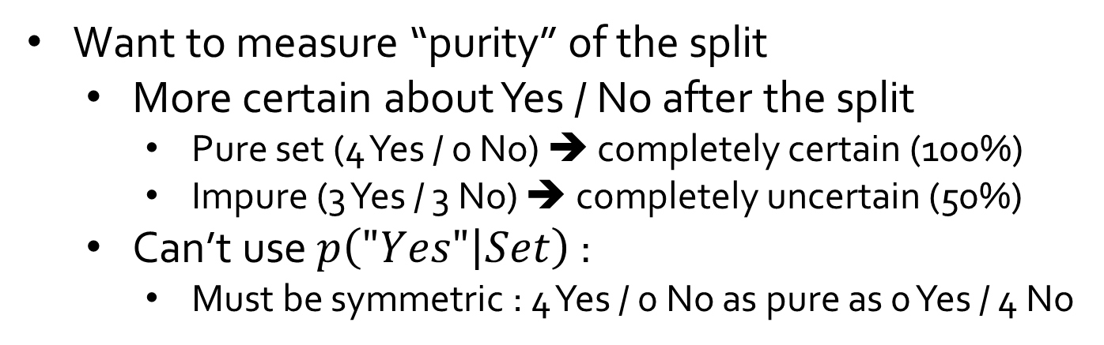
9Yes / 5 No
9Yes / 5 No
Outlook
Wind
Sunny
Overcast
Rain
Weak
Strong
2 Yes / 3 No
4 Yes / 0 No
3 Yes / 2 No
6 Yes / 2 No
3 Yes / 3 No
Want to measure “purity” of the split
More certain about Yes / No after the split
Pure set (4 Yes / 0 No) ➔ completely certain (100%)
Impure (3 Yes / 3 No) ➔ completely uncertain (50%)
Can’t use $p\left("Yes" | Set\right)$ :
Must be symmetric : 4 Yes / 0 No as pure as 0 Yes / 4 No

Slide 17
Outlook
Sunny
Overcast
Rain
Yes
Humidity
Wind
High
Normal
Strong
Weak
No
Yes
No
Yes
Q : Why we choose outlook feature at the root node?
A : Outlook is the most informative feature, i.e. the purest feature

Slide 18
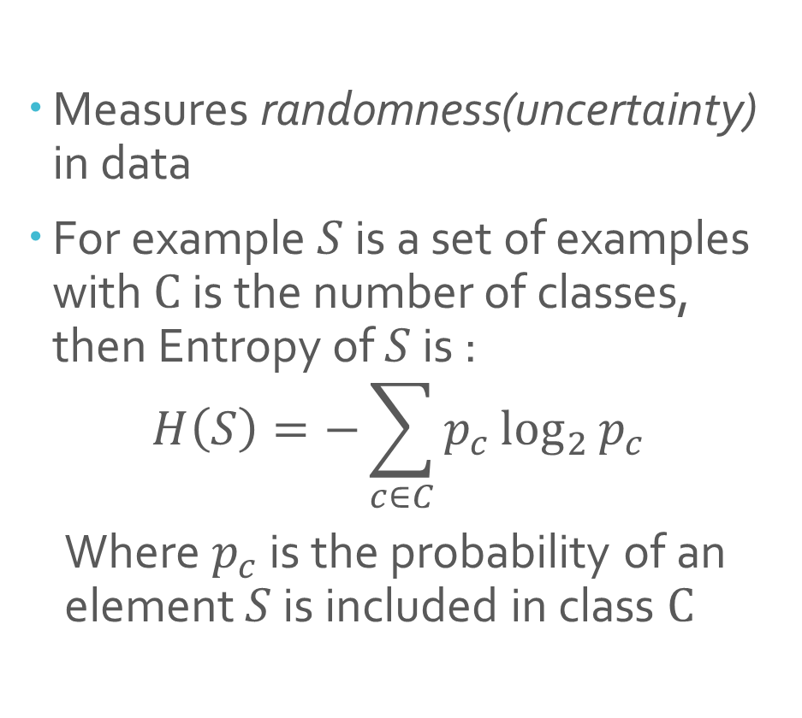
Entropy
Measures randomness(uncertainty) in data
For example $S$ is a set of examples with $C$ is the number of classes, then Entropy of $S$ is :
$$H\left(S\right)=−\sum_{c∈C}{p_{c}\log_{2}{p_{c}}}$$
Where $p_{c}$ is the probability of an element $S$ is included in class $C$

Slide 19
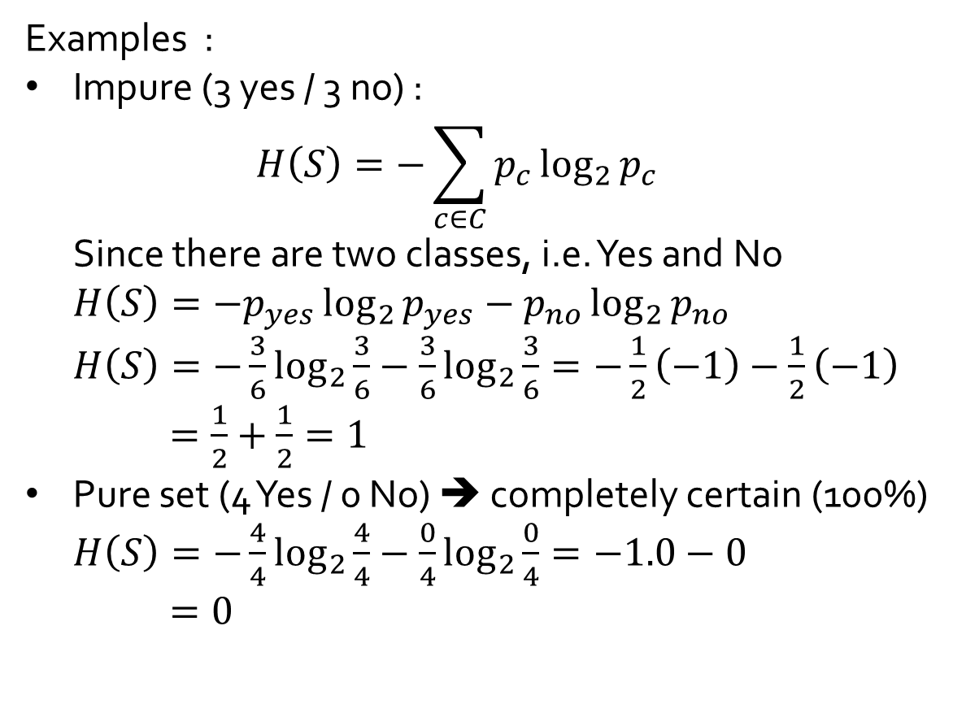
Examples :
Impure (3 yes / 3 no) :
$$H\left(S\right)=−\sum_{c∈C}{p_{c}\log_{2}{p_{c}}}$$
Since there are two classes, i.e. Yes and No
$$H\left(S\right)=−p_{yes}\log_{2}{p_{yes}}−p_{no}\log_{2}{p_{no}}$$
$H\left(S\right)=−\frac{3}{6}\log_{2}{\frac{3}{6}}−\frac{3}{6}\log_{2}{\frac{3}{6}}=−\frac{1}{2}\left(−1\right)−\frac{1}{2}\left(−1\right)$
$=\frac{1}{2}+\frac{1}{2}=1$
Pure set (4 Yes / 0 No) ➔ completely certain (100%)
$H\left(S\right)=−\frac{4}{4}\log_{2}{\frac{4}{4}}−\frac{0}{4}\log_{2}{\frac{0}{4}}=−1.0−0$
$=0$

Slide 20
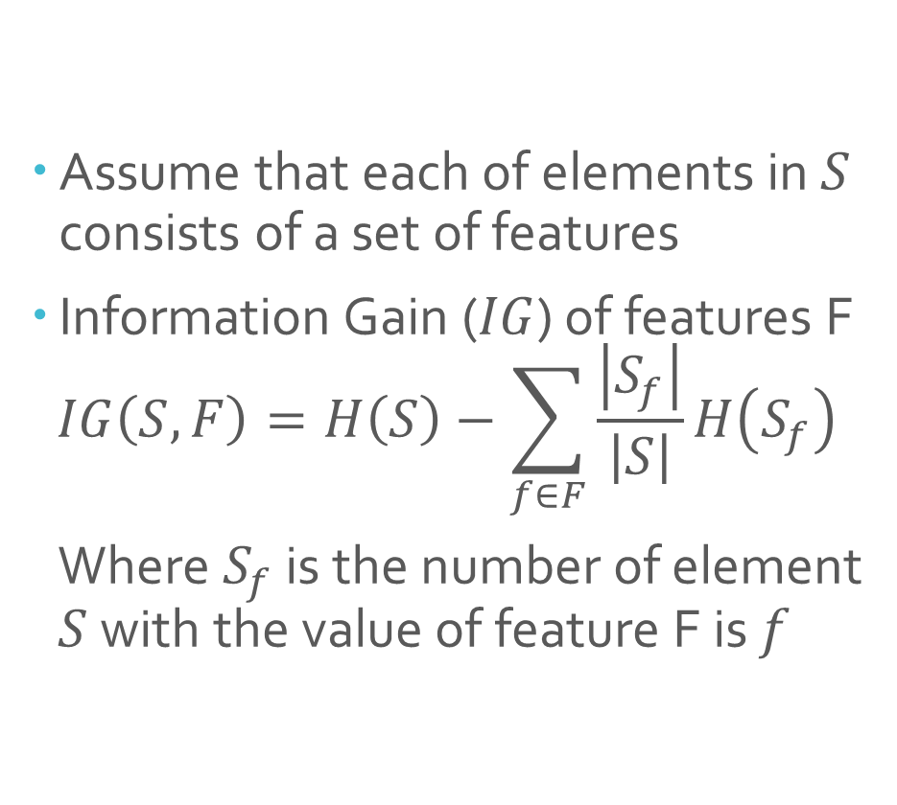
Information Gain
Assume that each of elements in $S$ consists of a set of features
Information Gain ($IG$) of features F
$$IG\left(S,F\right)=H\left(S\right)−\sum_{f∈F}{\frac{\left|S_{f}\right|}{\left|S\right|}H\left(S_{f}\right)}$$
Where $S_{f}$ is the number of element $S$ with the value of feature F is $f$

Slide 21
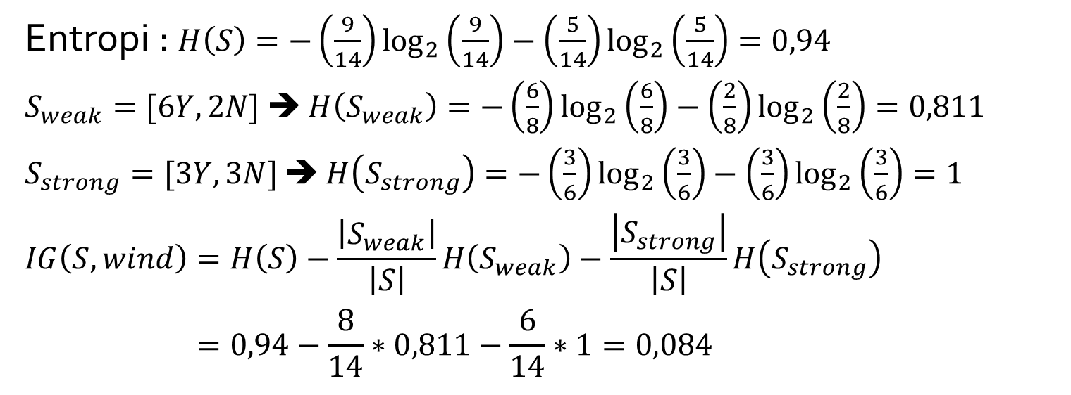
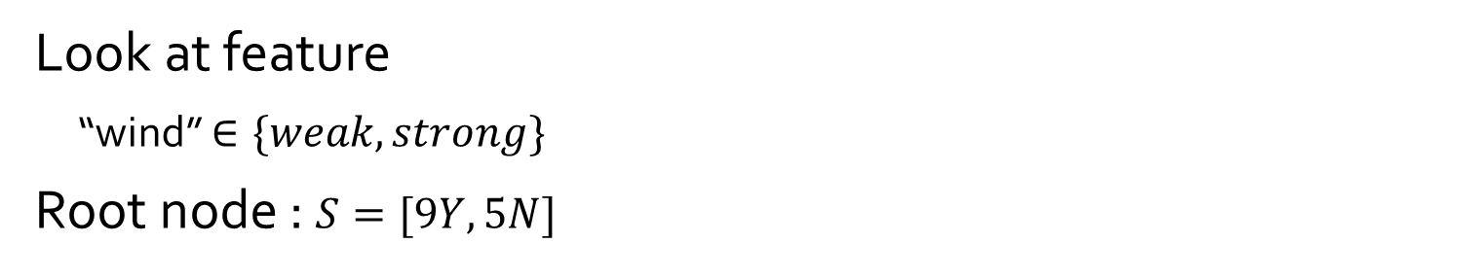
Previous Examples :
Look at feature
“wind” $∈\{weak,strong\}$
Root node : $S=[9Y,5N]$
Entropi : $H\left(S\right)=−\left(\frac{9}{14}\right)\log_{2}\left(\frac{9}{14}\right)−\left(\frac{5}{14}\right)\log_{2}\left(\frac{5}{14}\right)=0,94$
$S_{weak}=[6Y,2N]$ ➔ $H\left(S_{weak}\right)=−\left(\frac{6}{8}\right)\log_{2}\left(\frac{6}{8}\right)−\left(\frac{2}{8}\right)\log_{2}\left(\frac{2}{8}\right)=0,811$
$S_{strong}=[3Y,3N]$ ➔ $H\left(S_{strong}\right)=−\left(\frac{3}{6}\right)\log_{2}\left(\frac{3}{6}\right)−\left(\frac{3}{6}\right)\log_{2}\left(\frac{3}{6}\right)=1$
$$IG\left(S,wind\right)=H\left(S\right)−\frac{\left|S_{weak}\right|}{\left|S\right|}H\left(S_{weak}\right)−\frac{\left|S_{strong}\right|}{\left|S\right|}H\left(S_{strong}\right)$$
$$=0,94−\frac{8}{14}∗0,811−\frac{6}{14}∗1=0,084$$

Slide 22
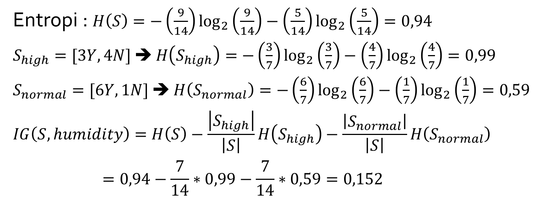
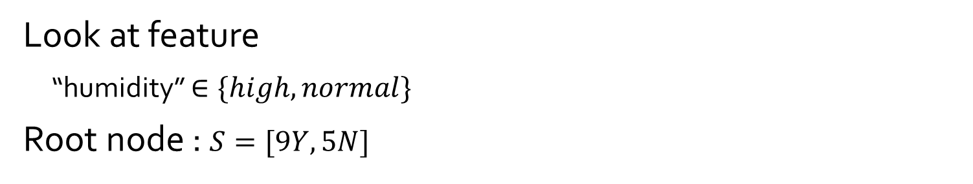
Previous Examples :
Look at feature
“humidity” $∈\{high,normal\}$
Root node : $S=[9Y,5N]$
Entropi : $H\left(S\right)=−\left(\frac{9}{14}\right)\log_{2}\left(\frac{9}{14}\right)−\left(\frac{5}{14}\right)\log_{2}\left(\frac{5}{14}\right)=0,94$
$S_{high}=[3Y,4N]$ ➔ $H\left(S_{high}\right)=−\left(\frac{3}{7}\right)\log_{2}\left(\frac{3}{7}\right)−\left(\frac{4}{7}\right)\log_{2}\left(\frac{4}{7}\right)=0,99$
$S_{normal}=[6Y,1N]$ ➔ $H\left(S_{normal}\right)=−\left(\frac{6}{7}\right)\log_{2}\left(\frac{6}{7}\right)−\left(\frac{1}{7}\right)\log_{2}\left(\frac{1}{7}\right)=0,59$
$$IG\left(S,humidity\right)=H\left(S\right)−\frac{\left|S_{high}\right|}{\left|S\right|}H\left(S_{high}\right)−\frac{\left|S_{normal}\right|}{\left|S\right|}H\left(S_{normal}\right)$$
$$=0,94−\frac{7}{14}∗0,99−\frac{7}{14}∗0,59=0,152$$

Slide 23
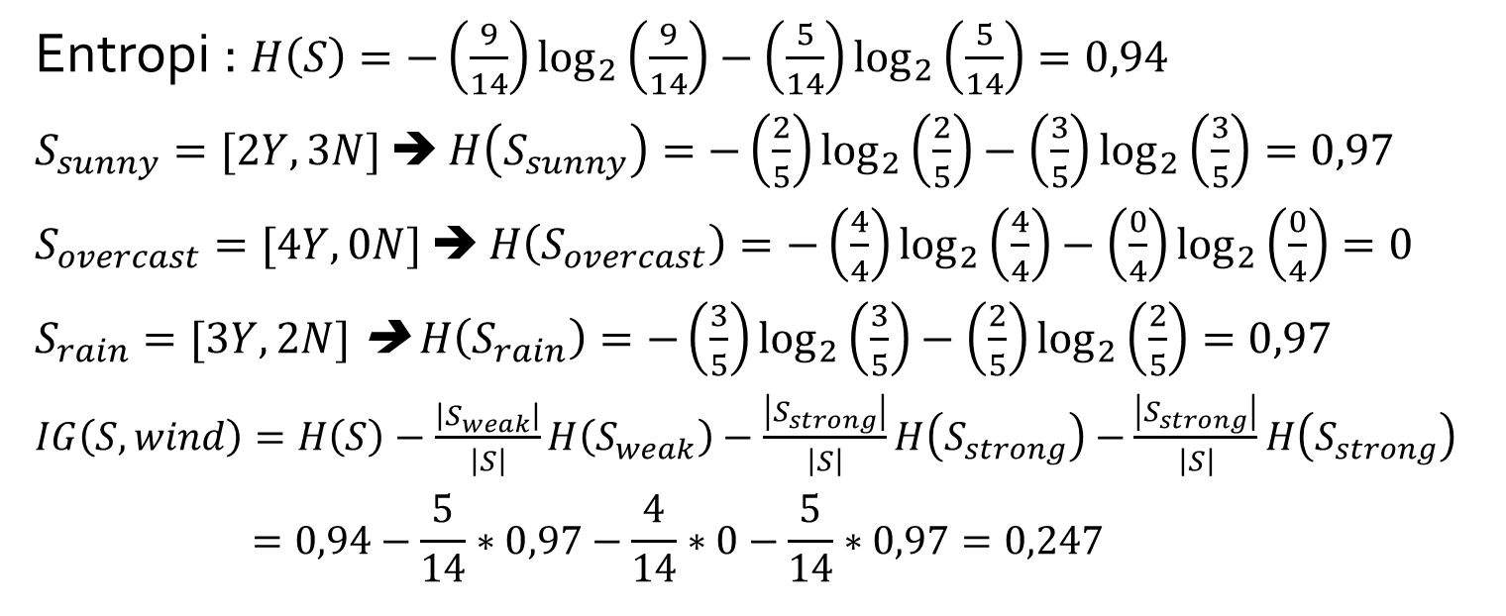
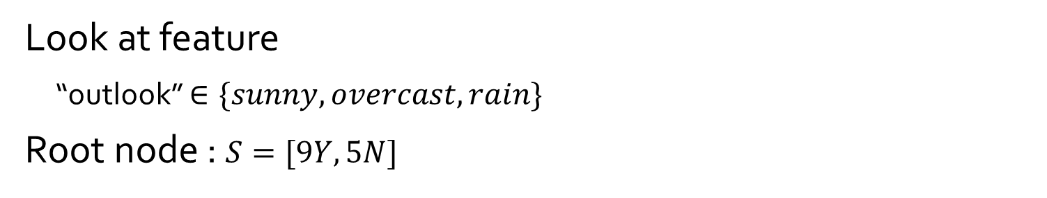
Previous Examples :
Look at feature
“outlook” $∈\{sunny,overcast,rain\}$
Root node : $S=[9Y,5N]$
Entropi : $H\left(S\right)=−\left(\frac{9}{14}\right)\log_{2}\left(\frac{9}{14}\right)−\left(\frac{5}{14}\right)\log_{2}\left(\frac{5}{14}\right)=0,94$
$S_{sunny}=[2Y,3N]$ ➔ $H\left(S_{sunny}\right)=−\left(\frac{2}{5}\right)\log_{2}\left(\frac{2}{5}\right)−\left(\frac{3}{5}\right)\log_{2}\left(\frac{3}{5}\right)=0,97$
$S_{overcast}=[4Y,0N]$ ➔ $H\left(S_{overcast}\right)=−\left(\frac{4}{4}\right)\log_{2}\left(\frac{4}{4}\right)−\left(\frac{0}{4}\right)\log_{2}\left(\frac{0}{4}\right)=0$
$S_{rain}=[3Y,2N]$ ➔ $H\left(S_{rain}\right)=−\left(\frac{3}{5}\right)\log_{2}\left(\frac{3}{5}\right)−\left(\frac{2}{5}\right)\log_{2}\left(\frac{2}{5}\right)=0,97$
$IG\left(S,wind\right)=H\left(S\right)−\frac{\left|S_{weak}\right|}{\left|S\right|}H\left(S_{weak}\right)−\frac{\left|S_{strong}\right|}{\left|S\right|}H\left(S_{strong}\right)−$ $\frac{\left|S_{strong}\right|}{\left|S\right|}H\left(S_{strong}\right)$
$$=0,94−\frac{5}{14}∗0,97−\frac{4}{14}∗0−\frac{5}{14}∗0,97=0,247$$

Slide 24
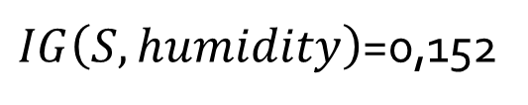
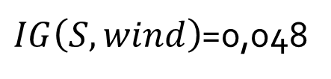
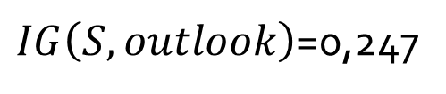
The obtained value of information gain are :
“Outlook” has the highest IG value ➔ it is set as a root node
Growing the tree
Iteratively select the feature with the highest information gain for each child of the previous node
$IG\left(S,wind\right)$=0,048
$IG\left(S,humidity\right)$=0,152
$IG\left(S,outlook\right)$=0,247

Slide 25
Outlook
Sunny
Overcast
Rain
2 Yes / 3 No ➔ Split Further
3Yes / 2 No ➔ Split Further
4 Yes / 0 No ➔ Pure Subset

Slide 26
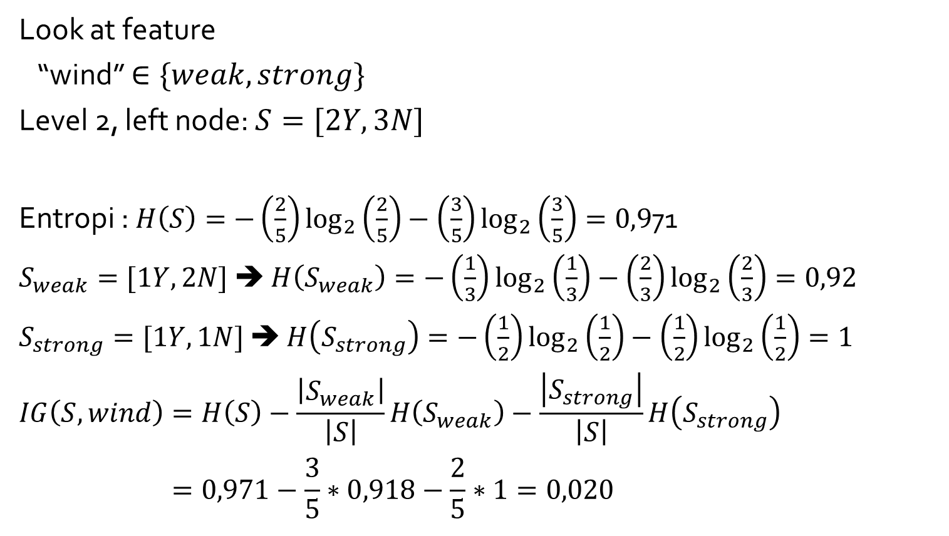
Growing The Tree
Look at feature
“wind” $∈\{weak,strong\}$
Level 2, left node: $S=[2Y,3N]$
Entropi : $H\left(S\right)=−\left(\frac{2}{5}\right)\log_{2}\left(\frac{2}{5}\right)−\left(\frac{3}{5}\right)\log_{2}\left(\frac{3}{5}\right)=0,9$71
$S_{weak}=[1Y,2N]$ ➔ $H\left(S_{weak}\right)=−\left(\frac{1}{3}\right)\log_{2}\left(\frac{1}{3}\right)−\left(\frac{2}{3}\right)\log_{2}\left(\frac{2}{3}\right)=0,92$
$S_{strong}=[1Y,1N]$ ➔ $H\left(S_{strong}\right)=−\left(\frac{1}{2}\right)\log_{2}\left(\frac{1}{2}\right)−\left(\frac{1}{2}\right)\log_{2}\left(\frac{1}{2}\right)=1$
$$IG\left(S,wind\right)=H\left(S\right)−\frac{\left|S_{weak}\right|}{\left|S\right|}H\left(S_{weak}\right)−\frac{\left|S_{strong}\right|}{\left|S\right|}H\left(S_{strong}\right)$$
$$=0,971−\frac{3}{5}∗0,918−\frac{2}{5}∗1=0,020$$
2 Yes / 3 No ➔ Split Further

Slide 27
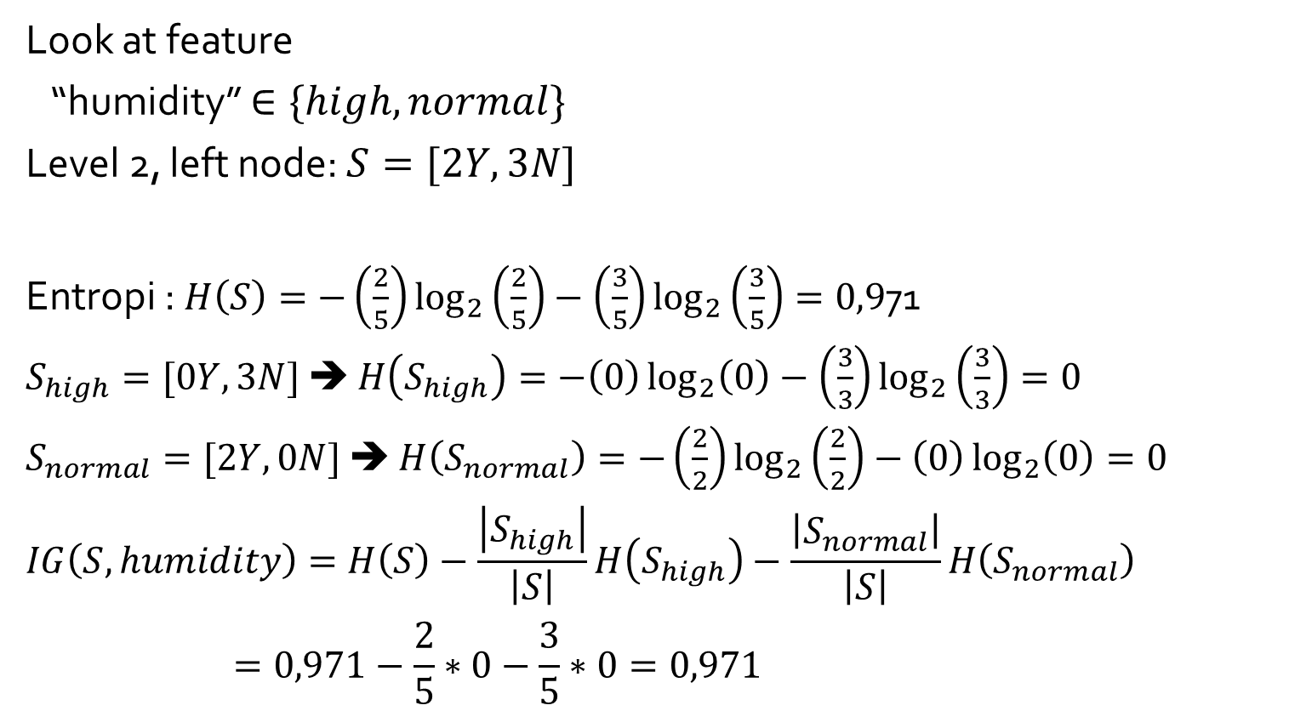
Growing The Tree
Look at feature
“humidity” $∈\{high,normal\}$
Level 2, left node: $S=[2Y,3N]$
Entropi : $H\left(S\right)=−\left(\frac{2}{5}\right)\log_{2}\left(\frac{2}{5}\right)−\left(\frac{3}{5}\right)\log_{2}\left(\frac{3}{5}\right)=0,9$71
$S_{high}=[0Y,3N]$ ➔ $H\left(S_{high}\right)=−\left(0\right)\log_{2}\left(0\right)−\left(\frac{3}{3}\right)\log_{2}\left(\frac{3}{3}\right)=0$
$S_{normal}=[2Y,0N]$ ➔ $H\left(S_{normal}\right)=−\left(\frac{2}{2}\right)\log_{2}\left(\frac{2}{2}\right)−\left(0\right)\log_{2}\left(0\right)=0$
$$IG\left(S,humidity\right)=H\left(S\right)−\frac{\left|S_{high}\right|}{\left|S\right|}H\left(S_{high}\right)−\frac{\left|S_{normal}\right|}{\left|S\right|}H\left(S_{normal}\right)$$
$$=0,971−\frac{2}{5}∗0−\frac{3}{5}∗0=0,971$$
2 Yes / 3 No ➔ Split Further

Slide 28
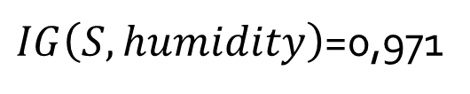
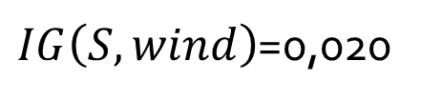
The obtained value of information gain are :
“Humidity” has the highest IG value ➔ it is set as a internal node for left side
$IG\left(S,wind\right)$=0,020
$IG\left(S,humidity\right)$=0,971

Slide 29
Outlook
Sunny
Overcast
Rain
Yes
Humidity
High
Normal
No
Yes

Slide 30
Outlook
Sunny
Overcast
Rain
2 Yes / 3 No ➔ Split Further
3Yes / 2 No ➔ Split Further
4 Yes / 0 No ➔ Pure Subset

Slide 31
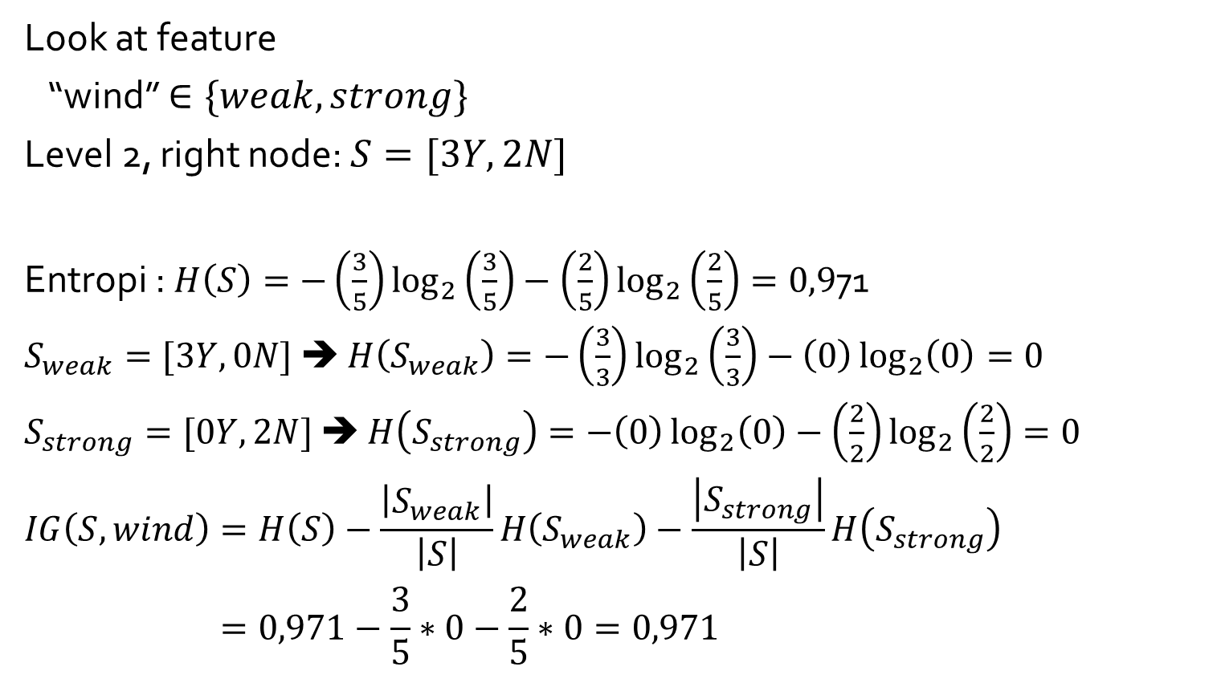
Growing The Tree
Look at feature
“wind” $∈\{weak,strong\}$
Level 2, right node: $S=[3Y,2N]$
Entropi : $H\left(S\right)=−\left(\frac{3}{5}\right)\log_{2}\left(\frac{3}{5}\right)−\left(\frac{2}{5}\right)\log_{2}\left(\frac{2}{5}\right)=0,9$71
$S_{weak}=[3Y,0N]$ ➔ $H\left(S_{weak}\right)=−\left(\frac{3}{3}\right)\log_{2}\left(\frac{3}{3}\right)−\left(0\right)\log_{2}\left(0\right)=0$
$S_{strong}=[0Y,2N]$ ➔ $H\left(S_{strong}\right)=−\left(0\right)\log_{2}\left(0\right)−\left(\frac{2}{2}\right)\log_{2}\left(\frac{2}{2}\right)=0$
$$IG\left(S,wind\right)=H\left(S\right)−\frac{\left|S_{weak}\right|}{\left|S\right|}H\left(S_{weak}\right)−\frac{\left|S_{strong}\right|}{\left|S\right|}H\left(S_{strong}\right)$$
$$=0,971−\frac{3}{5}∗0−\frac{2}{5}∗0=0,971$$
2 Yes / 3 No ➔ Split Further

Slide 32
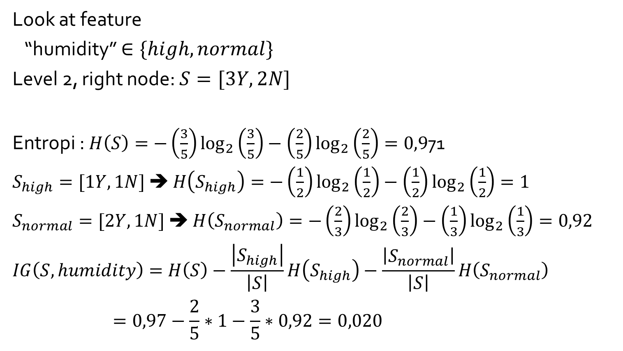
Growing The Tree
Look at feature
“humidity” $∈\{high,normal\}$
Level 2, right node: $S=[3Y,2N]$
Entropi : $H\left(S\right)=−\left(\frac{3}{5}\right)\log_{2}\left(\frac{3}{5}\right)−\left(\frac{2}{5}\right)\log_{2}\left(\frac{2}{5}\right)=0,9$71
$S_{high}=[1Y,1N]$ ➔ $H\left(S_{high}\right)=−\left(\frac{1}{2}\right)\log_{2}\left(\frac{1}{2}\right)−\left(\frac{1}{2}\right)\log_{2}\left(\frac{1}{2}\right)=1$
$S_{normal}=[2Y,1N]$ ➔ $H\left(S_{normal}\right)=−\left(\frac{2}{3}\right)\log_{2}\left(\frac{2}{3}\right)−\left(\frac{1}{3}\right)\log_{2}\left(\frac{1}{3}\right)=0,92$
$$IG\left(S,humidity\right)=H\left(S\right)−\frac{\left|S_{high}\right|}{\left|S\right|}H\left(S_{high}\right)−\frac{\left|S_{normal}\right|}{\left|S\right|}H\left(S_{normal}\right)$$
$$=0,97−\frac{2}{5}∗1−\frac{3}{5}∗0,92=0,020$$
2 Yes / 3 No ➔ Split Further

Slide 33
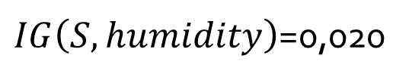
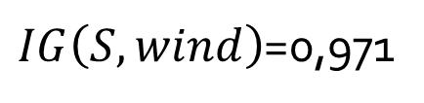
The obtained value of information gain are :
“Wind” has the highest IG value ➔ it is set as a internal node for ride side
$IG\left(S,wind\right)$=0,971
$IG\left(S,humidity\right)$=0,020

Slide 34
Outlook
Sunny
Overcast
Rain
Yes
Humidity
Wind
High
Normal
Strong
Weak
No
Yes
No
Yes

Slide 35
From Tree to Rules
Decision Tree

Slide 36
Outlook
Sunny
Overcast
Rain
Yes
Humidity
Wind
High
Normal
Strong
Weak
No
Yes
No
Yes
CONJUNCTION
$$IF Outlook=Sunny∧Humidity=High THEN PlayTennis=No$$

Slide 37
Outlook
Sunny
Overcast
Rain
Yes
Yes
Humidity
Another Example :
There is no relationship
to previous example
High
Normal
No
Yes
DISJUNCTION
$$IF Outlook=Overcast ∨Outlook=Rain THEN PlayTennis=Yes$$

Slide 38
Overfitting
Decision Tree

Slide 39
Outlook
Sunny
Overcast
Rain
Yes
Humidity
Wind
High
Normal
Strong
Weak
No
Yes
No
Yes
If we add noisy data to the dataset?
For example :
Outlook=Sunny, Humidity=Normal, Wind=Strong, PlayTennis = No
Based on the tree, it will be classified as PlayTennis = Yes

Slide 40
This node will need to be expanded by testing some other feature
The new tree would be more complex than the earlier one (trying to fit noise)
The extra complexity may not be worth it ⇒ may lead to overfitting if the test data follows the same pattern as our normal training data
Note: Overfitting may also occur if the training data is not sufficient

Slide 41
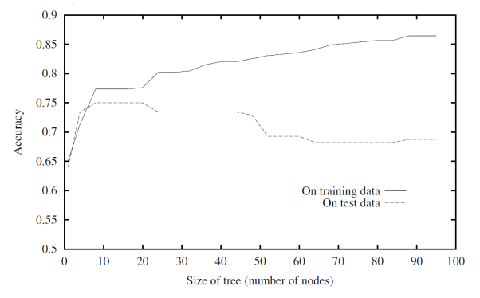
High training data accuracy doesn’t necessarily imply high test data accuracy

Slide 42
Avoid Overfitting
Desired: a DT that is not too big in size, yet fits the training data reasonably
Mainly two approaches:
Prune while building the tree (stopping early)
Prune after building the tree (post-pruning)

Slide 43
Criteria for judging which nodes could potentially be pruned
Use a validation set (separate from the training set)
Prune each possible node that doesn’t hurt the accuracy on the validation set
Greedily remove the node that improves the validation accuracy the most
Stop when the validation set accuracy starts worsening

Slide 44
C4.5 Algorithm
Decision Tree

Slide 45
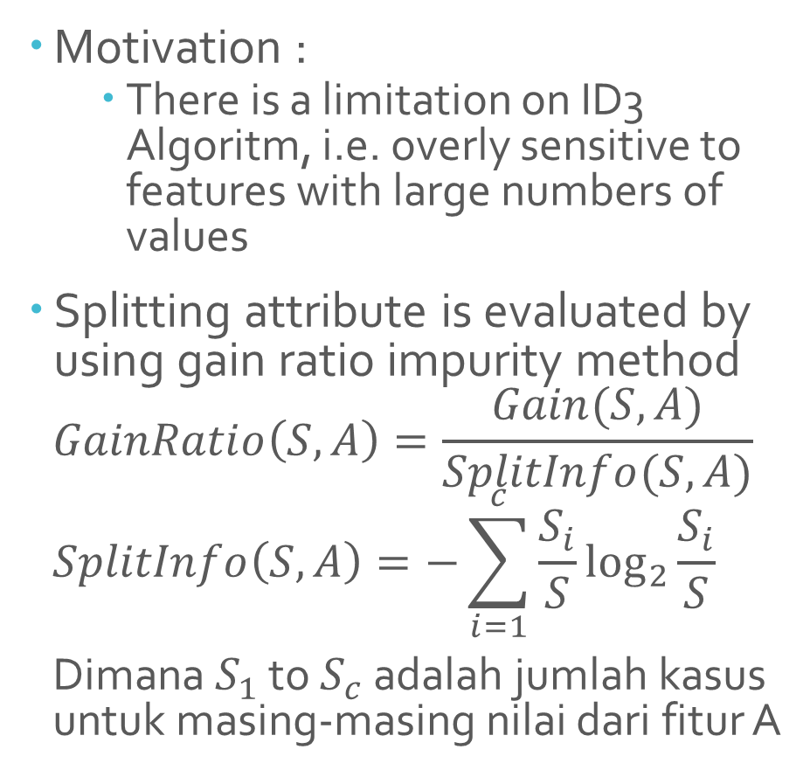
C4.5 Algorithm
Motivation :
There is a limitation on ID3 Algoritm, i.e. overly sensitive to features with large numbers of values
Splitting attribute is evaluated by using gain ratio impurity method
$$GainRatio\left(S,A\right)=\frac{Gain(S,A)}{SplitInfo(S,A)}$$
$$SplitInfo\left(S,A\right)=−\sum_{i=1}^{c}{\frac{S_{i}}{S}\log_{2}{\frac{S_{i}}{S}}}$$
Dimana $S_{1}$ to $S_{c}$ adalah jumlah kasus untuk masing-masing nilai dari fitur A

Slide 46
Example: Attribute values on Continuous Interval
Decision Tree

Slide 47
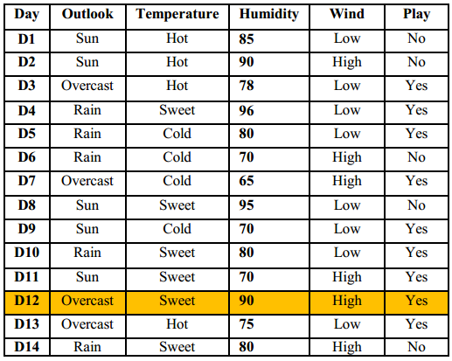
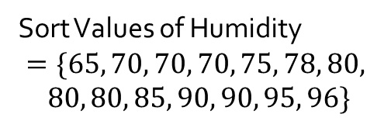
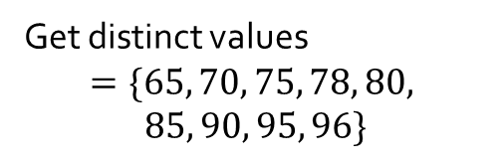
Sort Values of Humidity
$$=\{65, 70, 70, 70, 75, 78, 80,$$
$$80, 80, 85, 90, 90, 95, 96\}$$
Get distinct values
$$=\{65, 70, 75, 78, 80,$$
$$85, 90, 95, 96\}$$

Slide 48
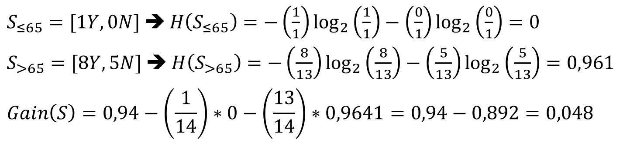
Interval | $$≤65$$ | $$>65$$
Yes | 1 | 8
No | 0 | 5
$$H\left(S\right)=−\left(\frac{9}{14}\right)\log_{2}\left(\frac{9}{14}\right)−\left(\frac{5}{14}\right)\log_{2}\left(\frac{5}{14}\right)=0,94$$
$S_{≤65}=[1Y,0N]$ ➔ $H\left(S_{≤65}\right)=−\left(\frac{1}{1}\right)\log_{2}\left(\frac{1}{1}\right)−\left(\frac{0}{1}\right)\log_{2}\left(\frac{0}{1}\right)=0$
$S_{>65}=[8Y,5N]$ ➔ $H\left(S_{>65}\right)=−\left(\frac{8}{13}\right)\log_{2}\left(\frac{8}{13}\right)−\left(\frac{5}{13}\right)\log_{2}\left(\frac{5}{13}\right)=0,961$
$$Gain\left(S\right)=0,94−\left(\frac{1}{14}\right)∗0−\left(\frac{13}{14}\right)∗0,9641=0,94−0,892=0,048$$
Perform against other threshold values

Slide 49
Data Representation
Decision Tree

Slide 50
DATA TO FEATURES
Most learning algorithms require the data in some numeric representation (e.g., each input pattern is a vector)
If the data naturally has numeric (real-valued) features, one way is to just represent it as a vector of real numbers
E.g., a 28 × 28 image by a 784 × 1 vector of its pixel intensities.
What if the data has a non-numeric representation
E.g., An email (a text document)

Slide 51
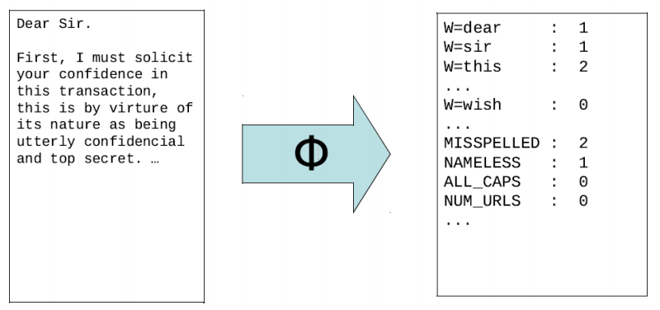
Data to Features: A Text Document
A possible feature vector representation for a text document

Slide 52
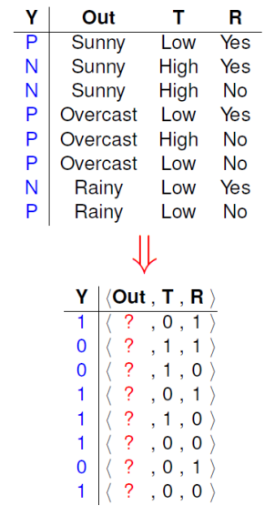
Data to Features: Symbolic/Categorical/Nominal Features
Let’s consider a dataset similar to the Tennis Playing example
Features are nominal (Low/High, Yes/No, Overcast/Rainy/Sunny, etc.)
Features with only 2 possible values can be represented as 0/1
What about features having more than 2 possible values?
Can’t we just map Sunny to 0, Overcast to 1, Rainy to 2?

Slide 53
Well, we could map Sunny to 0, Overcast to 1, Rainy to 2
But such a mapping may not always be appropriate
Imagine color being a feature in some data
Let’s code 3 possible colors as Red=0, Blue=1, Green=2
This implies Red is more similar to Blue than to Green

Slide 54
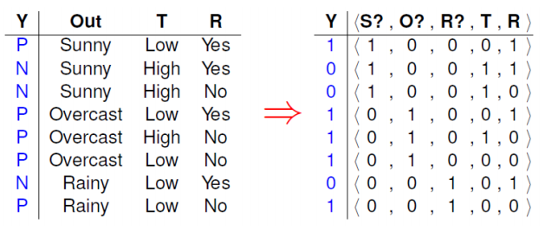
Solution: For a feature with K > 2 possible values, we usually create K binary features, one for each possible value

